Slide 1
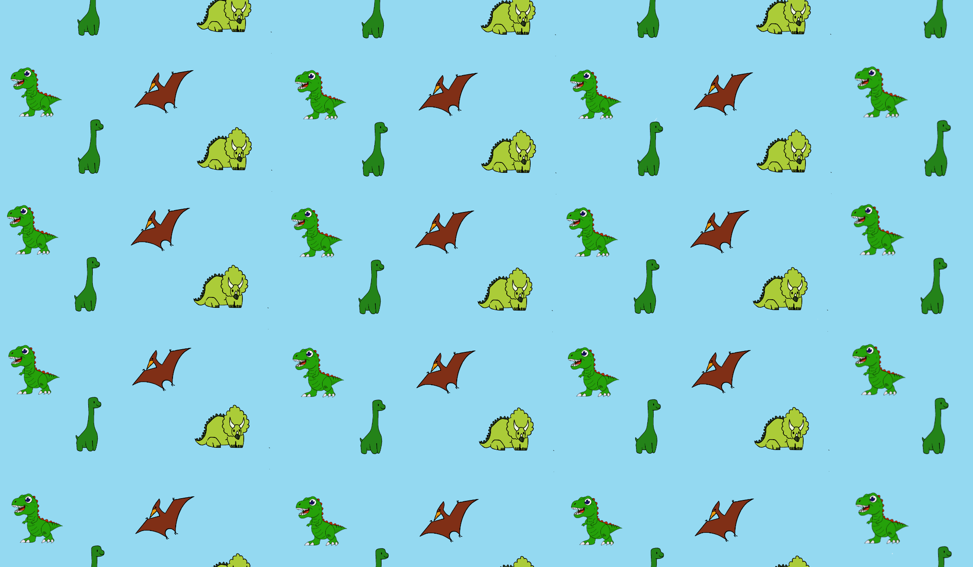

Welcome to Vector Infomeeting!
We start at 12:15
Notes:
Lucas PR

Slide 2
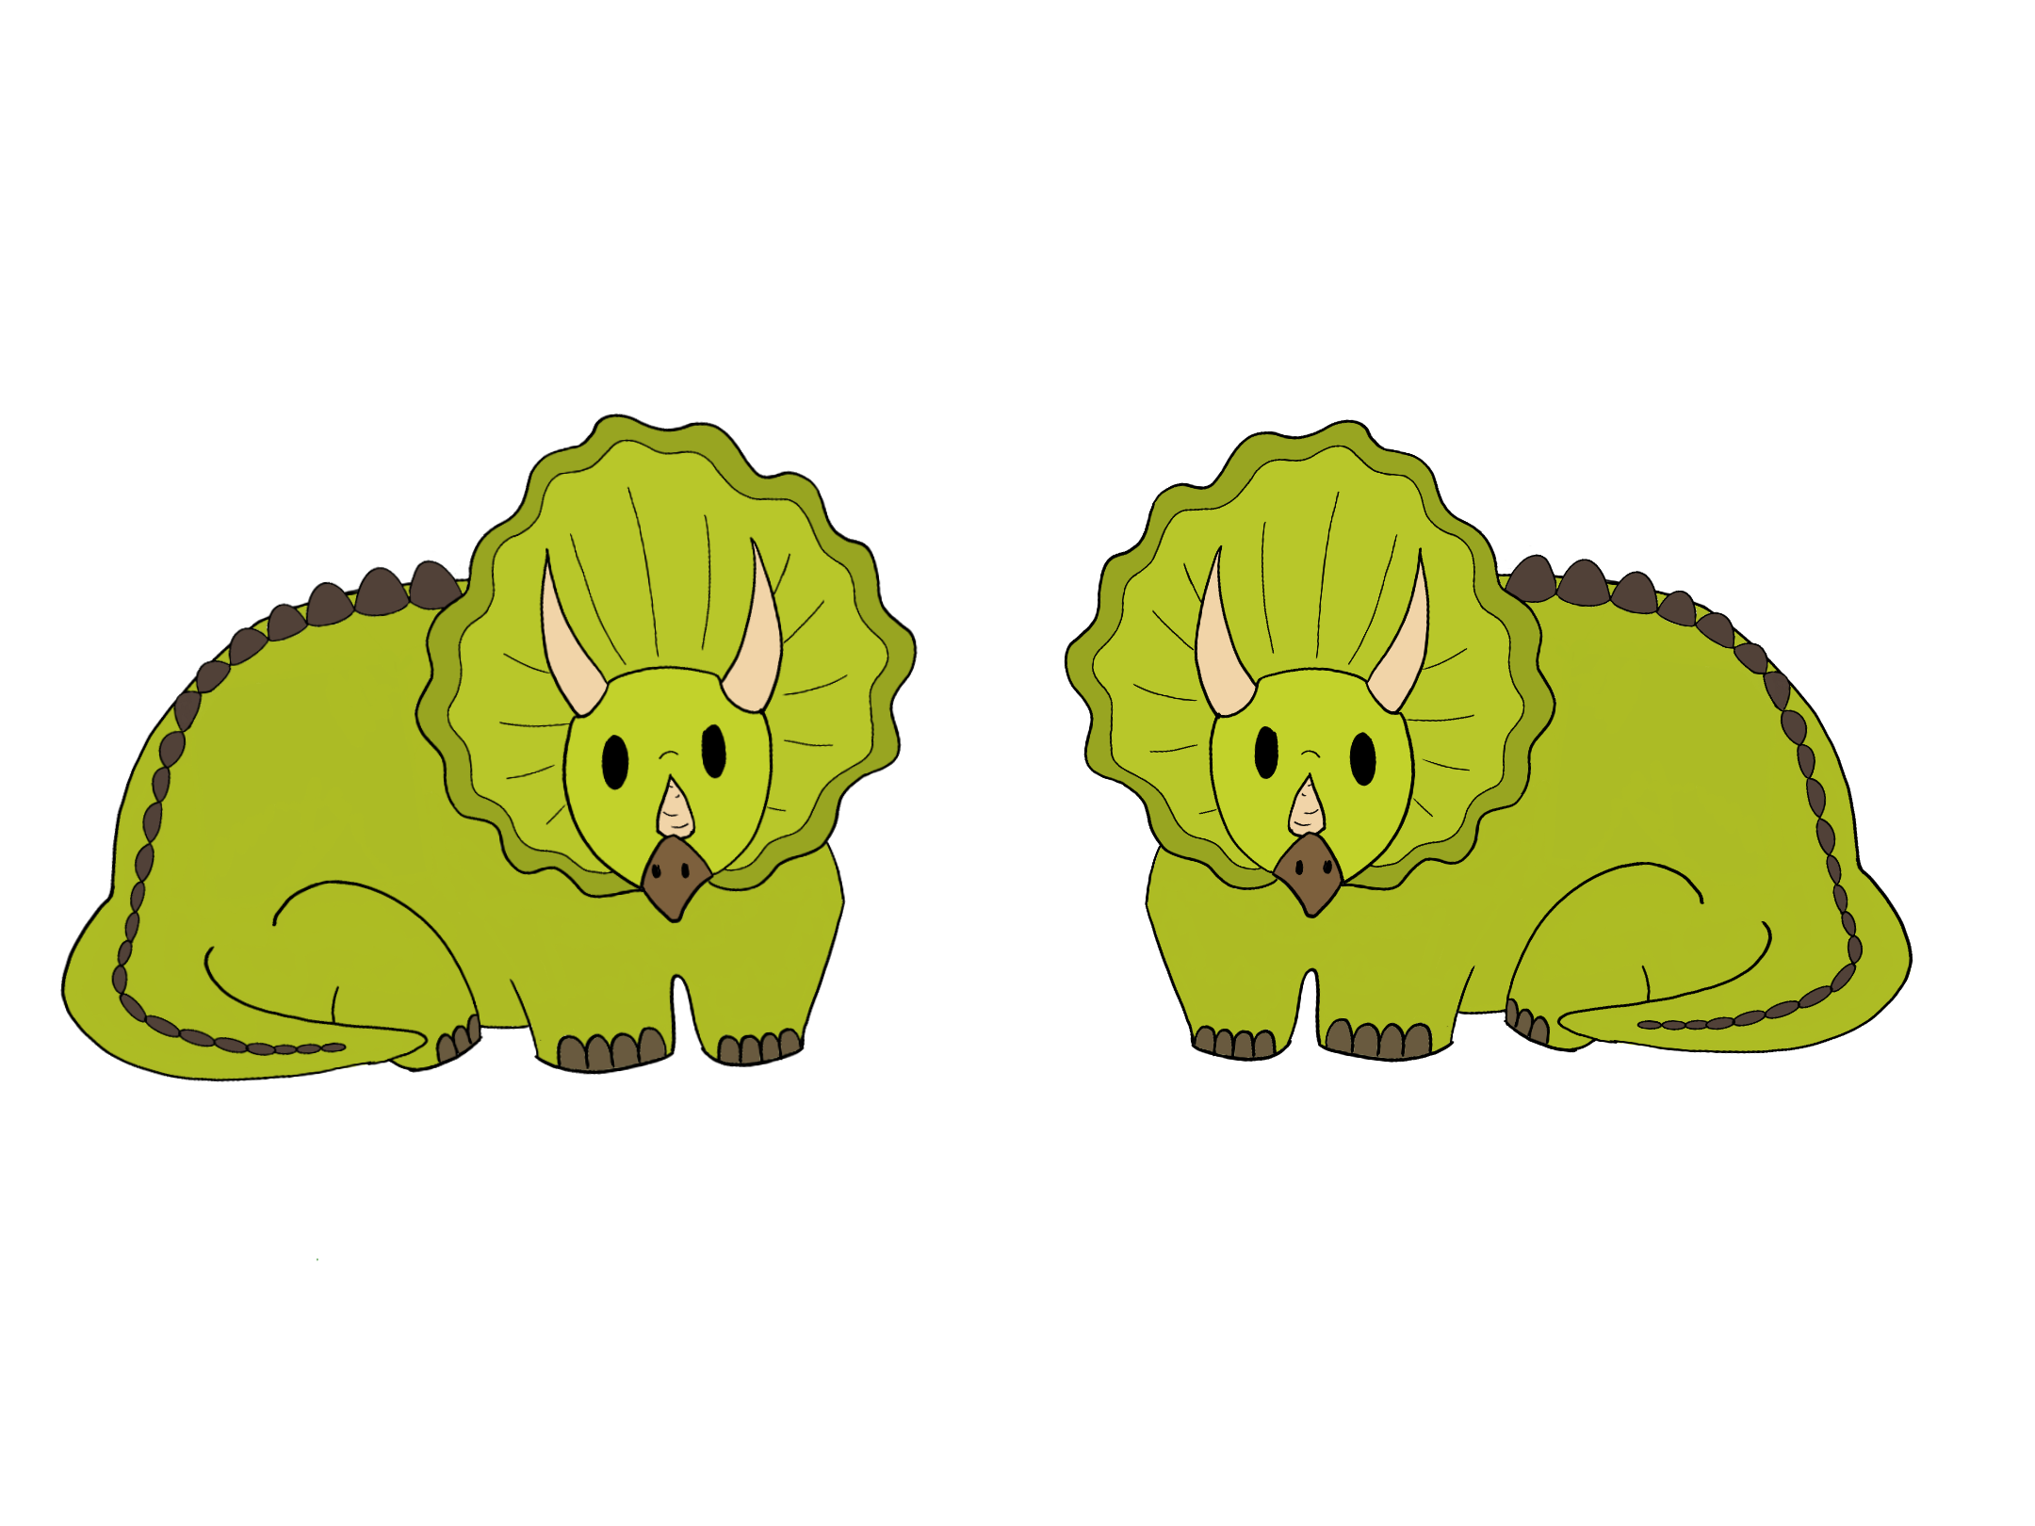
Agenda
Who are we?
What is a vector?
What does a vector do?
EDUcation
Intro-days
Optur
Pros and cons
Vector for another studyline
Important dates
How to apply?
Notes:
Lucas PR

Slide 3
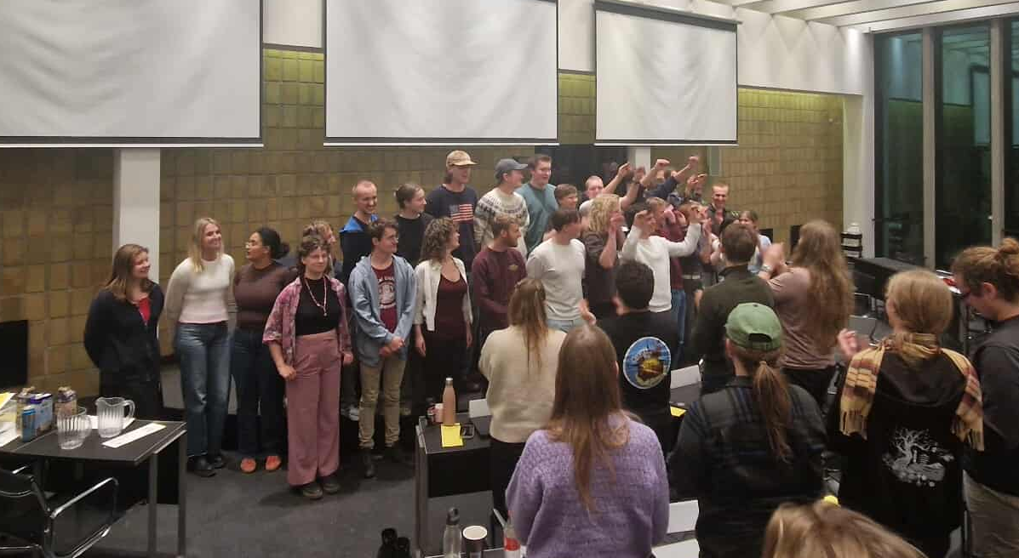

Who are we?
KABS26
  Coordinator of bachelor studystart
  30 KABS
Notes:
Cilla

Slide 4
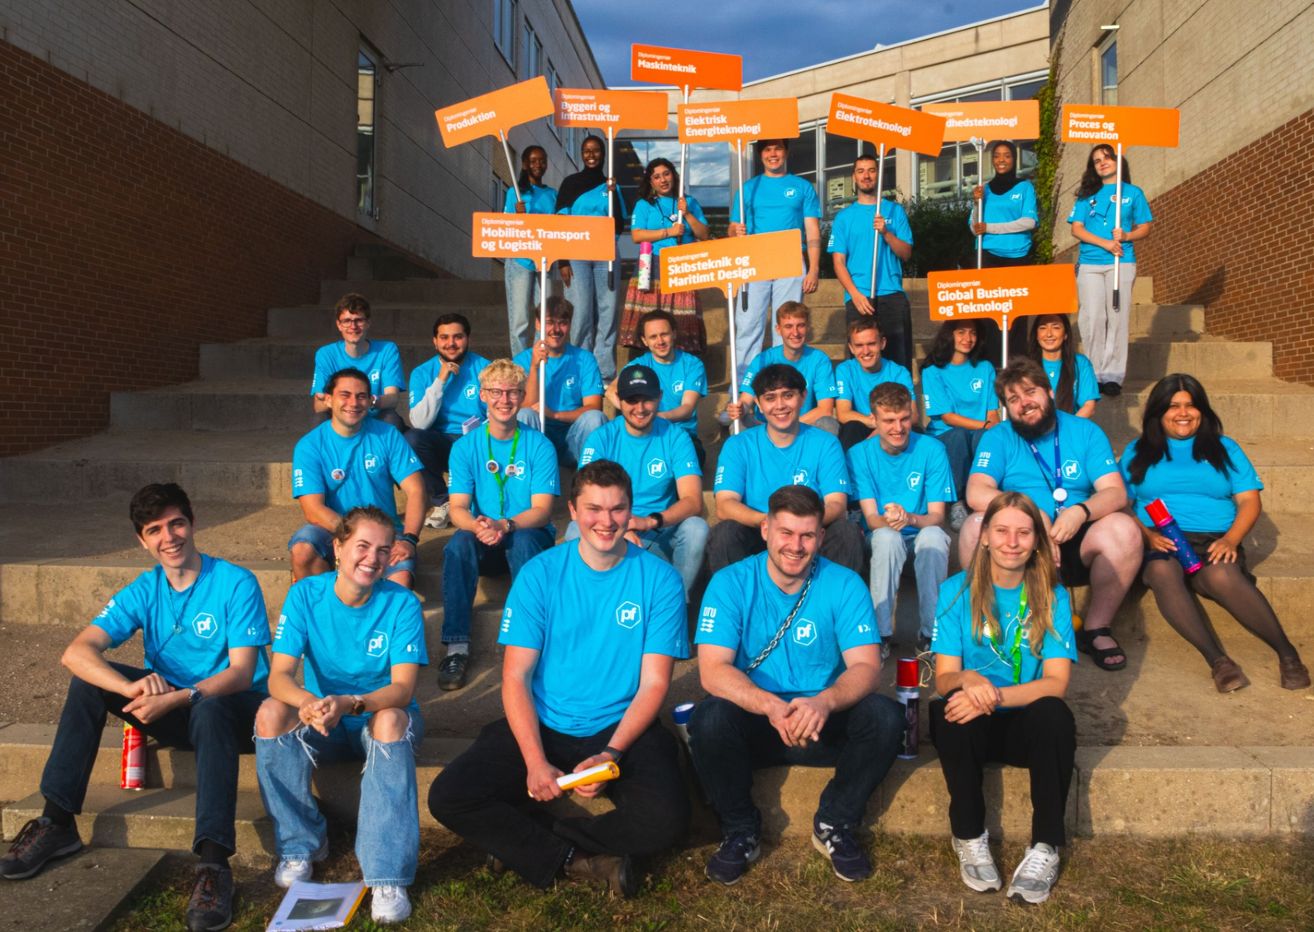
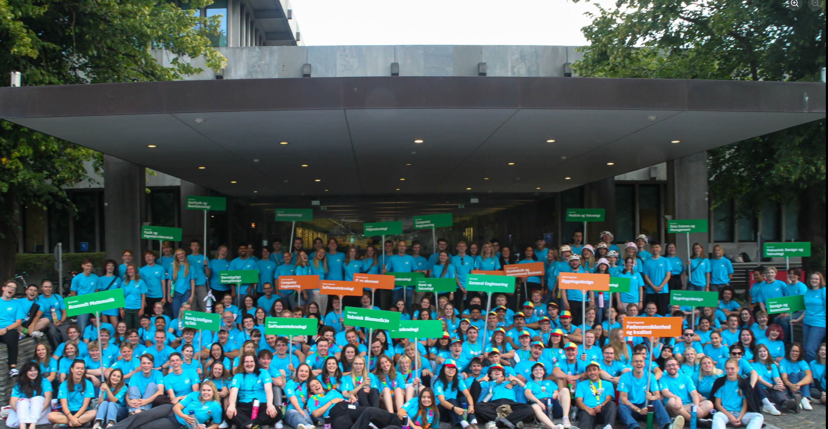
What is a vector?
Overall
The vector welcomes the new students
The first person they meet
Cross-teams
Intro-days
Mixed with other studylines
Study-line-teams
Plan and execute introdays and cabintrips
Do cakemeetings
Notes:
Katie

Slide 5
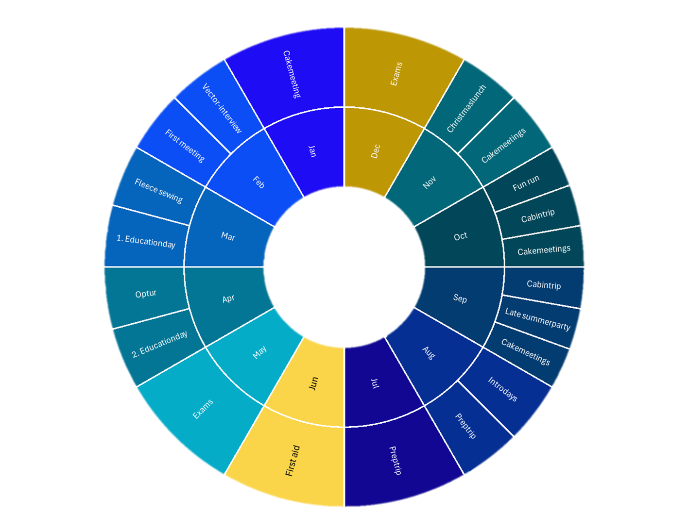
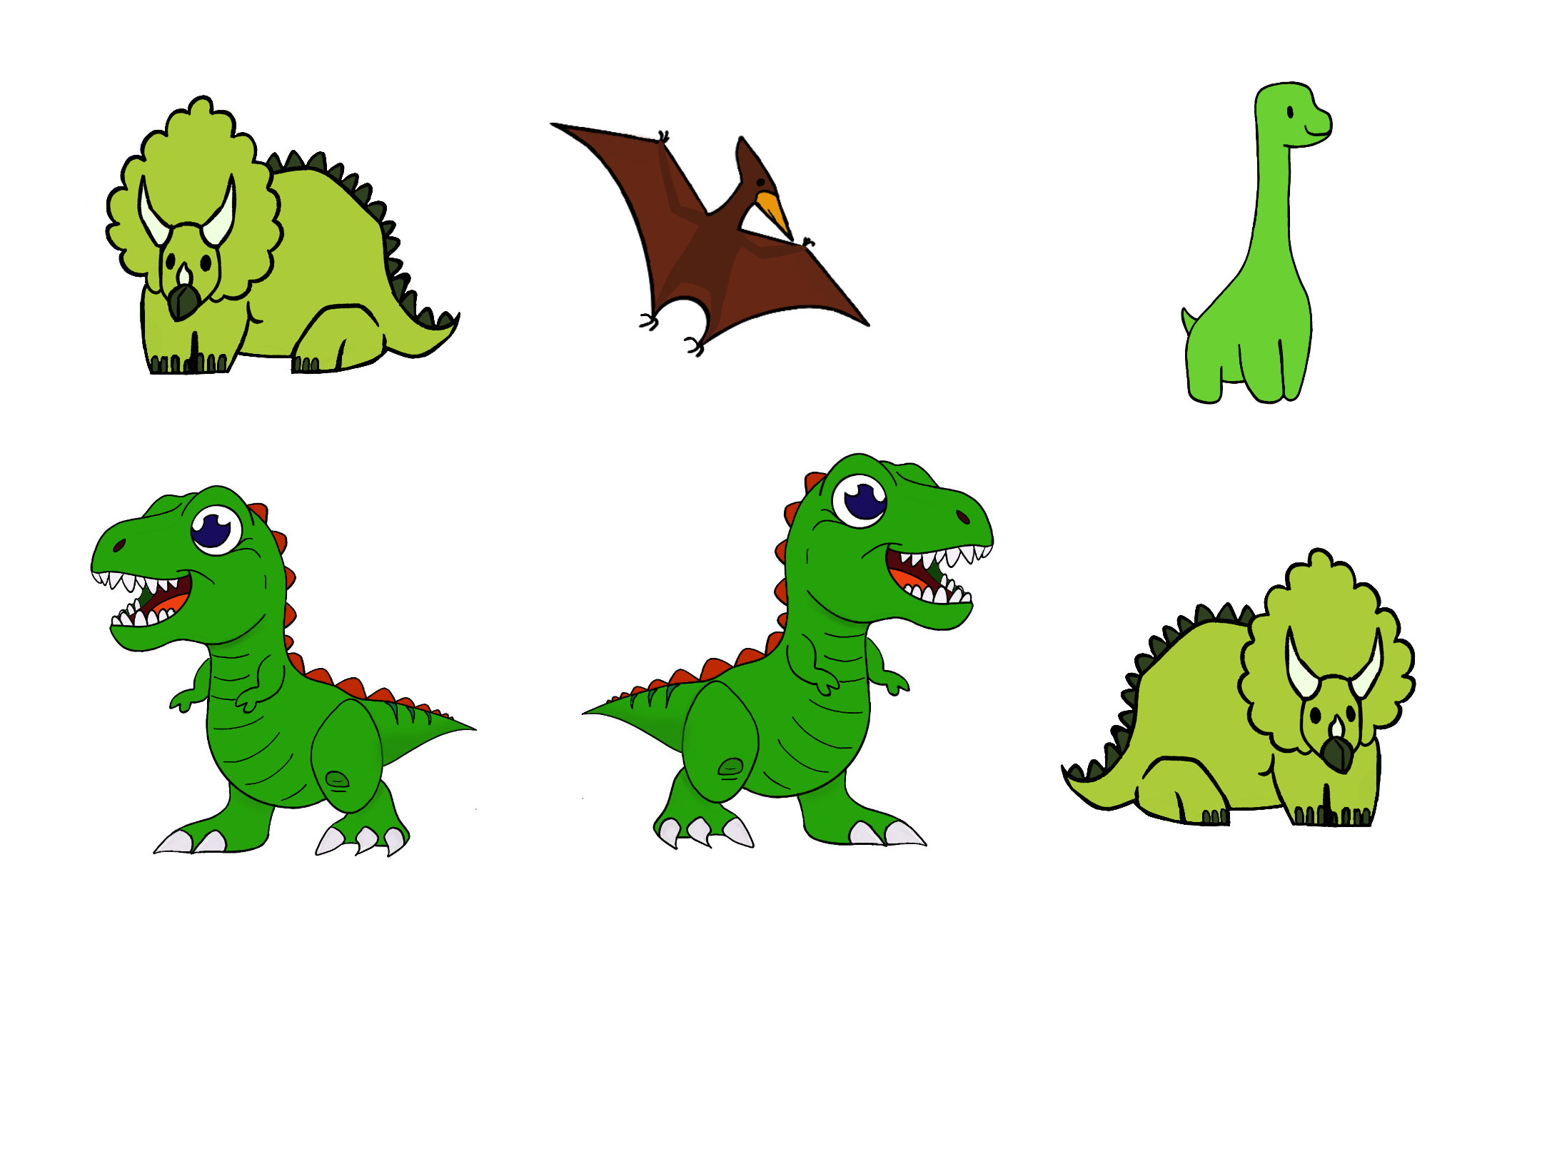
Year Wheel
Notes:
Mathias

Slide 6
What does a vector do?
Vector education
    - 2 Education days
    - First aid course
    - Further education during OPtur
    Vector meetings
        - Once a week
        - Alternately studyline and crossteam
        - Plan intro-days
    OPtur
        - Education
        - Fleece
        - Hygge
Notes:
Lucas

Slide 7
Education
Edu is responsible
Making the studystart feel safe for both Vectors and russes
Relevant experience to put on your resume
Notes:
marius

Slide 8
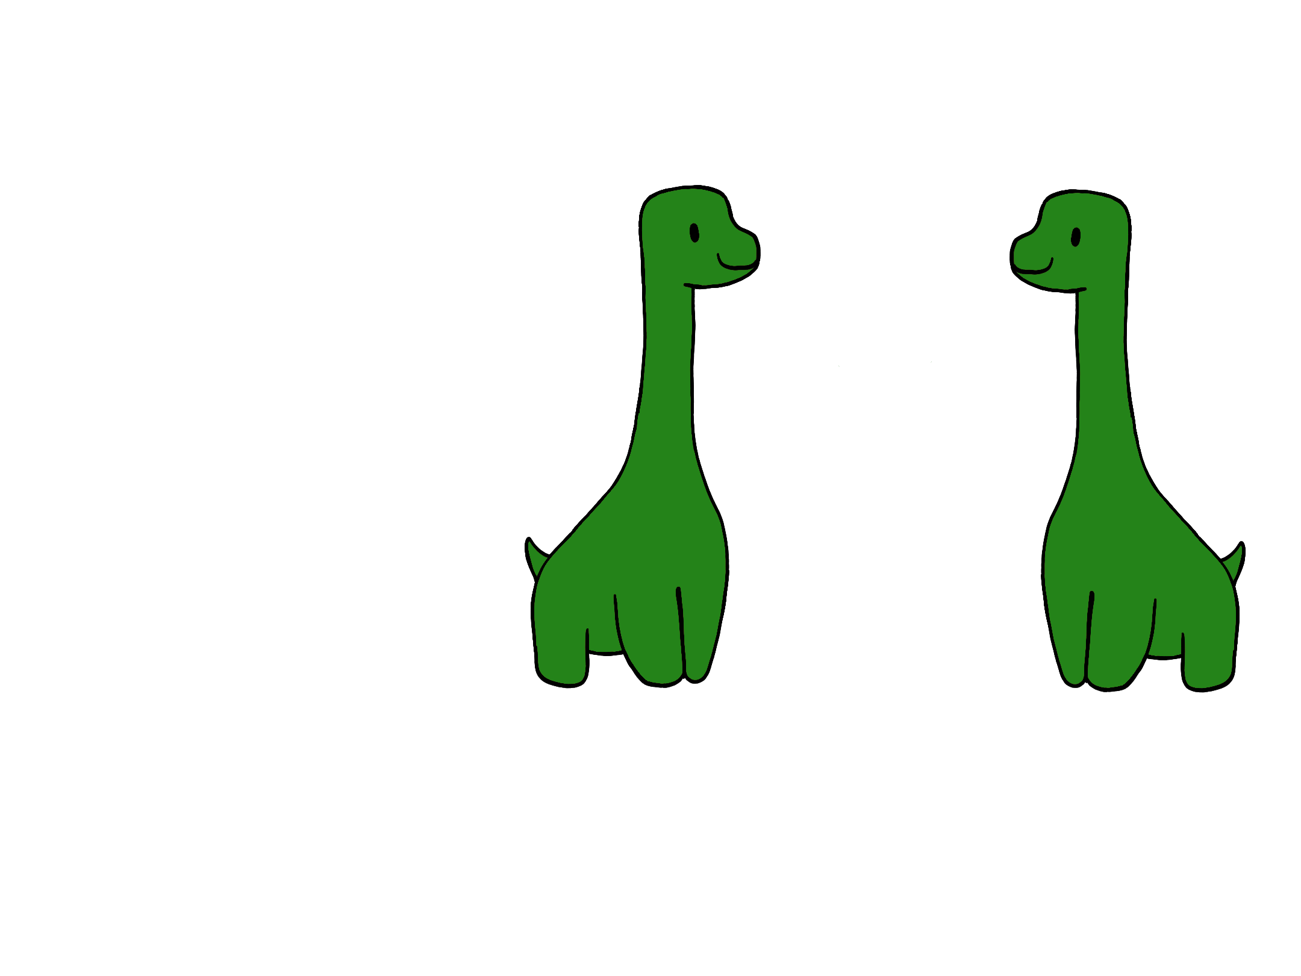
Vector-diploma
Through vector work and the education prepared for you, you will gain insight into:
Conflict management
Teamwork
Inclusion
Stress management
Event Planning
Education-days
15th of march
19th of april
Notes:
marius

Slide 9
INTRO DAYS
26-28 of august
Notes:
Malwina

Slide 10
Goal of the introdays
Build a social network for the new students
Tell practical information about DTU
Create a safe and including space for students
Make a fun introduction to student life at DTU
Notes:
Malwina

Slide 11
A vectors role
1. Creative planning
2. Organization of time and materials
3. Support cakemeetings
Notes:
Malwina

Slide 12
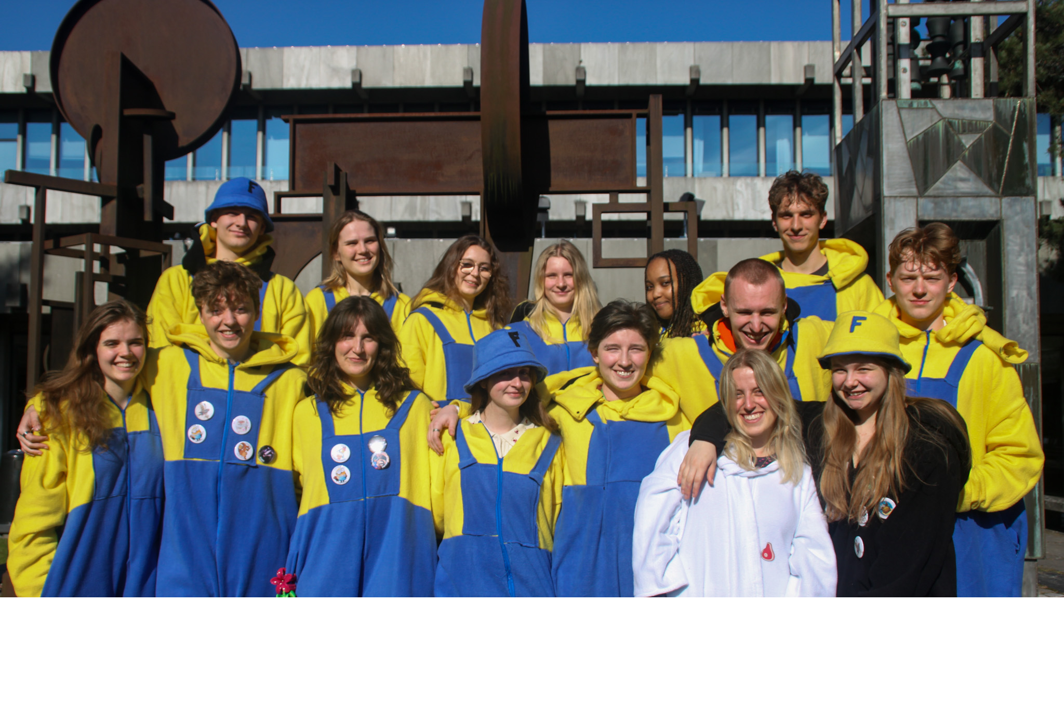
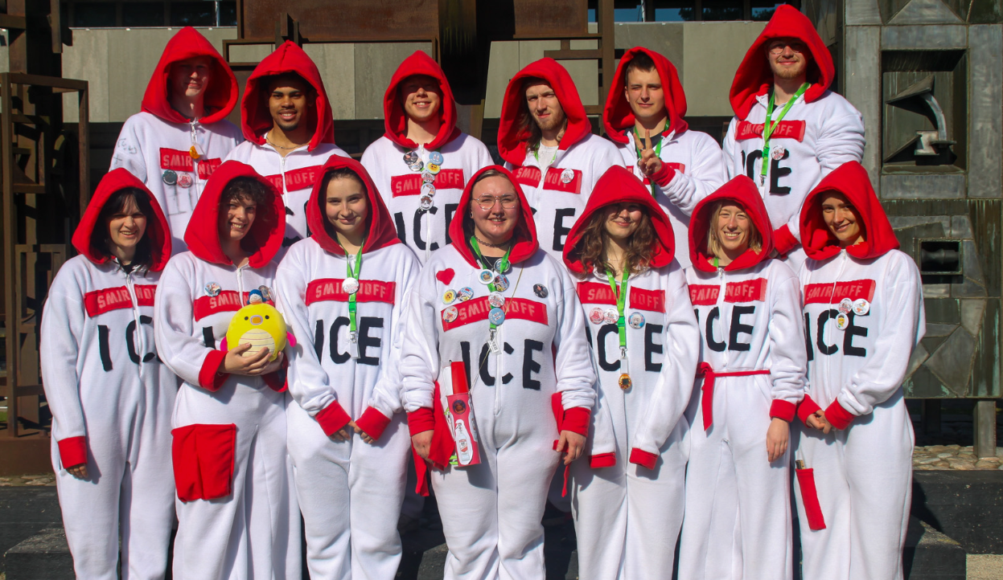
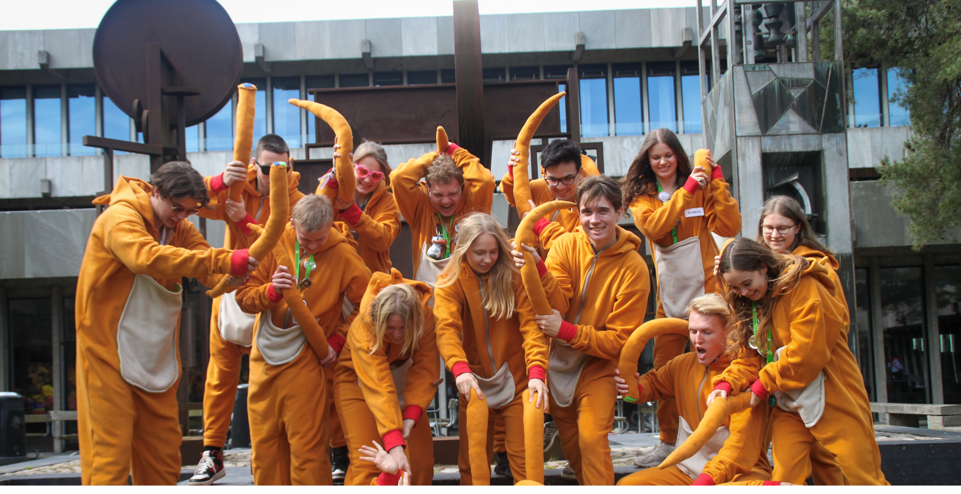
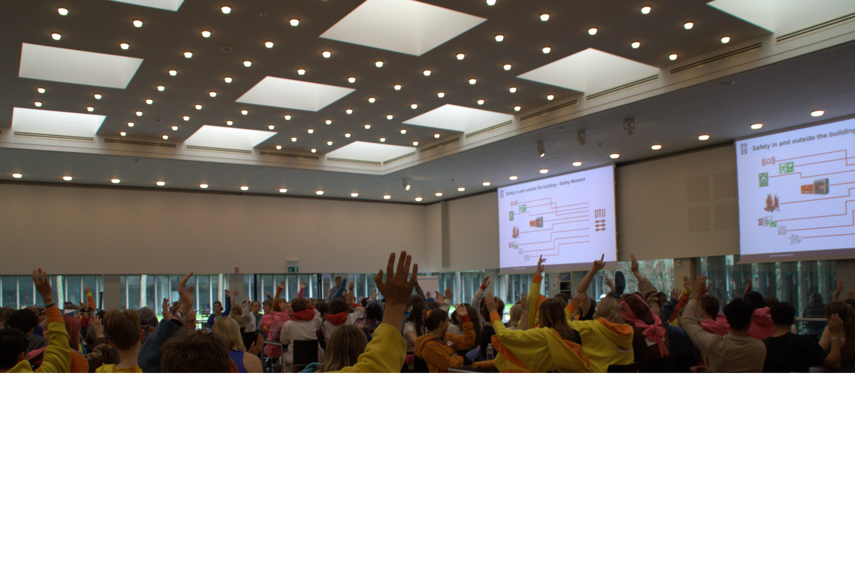
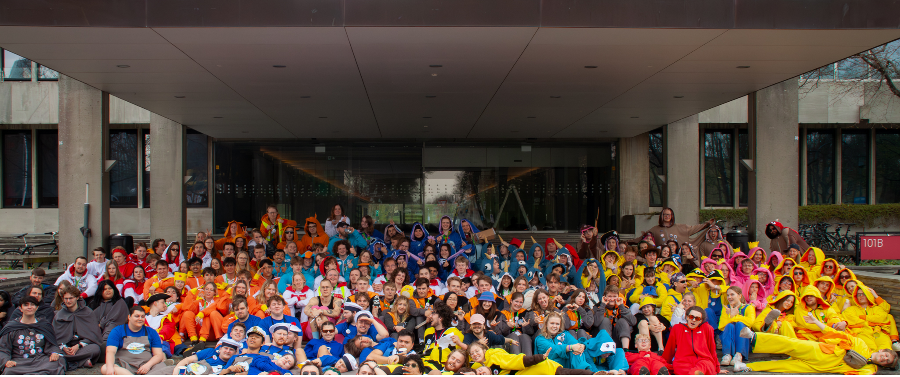
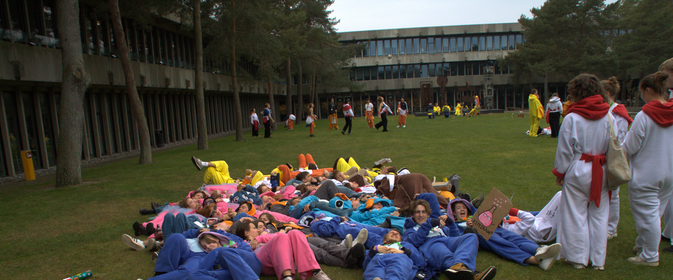
OPtur 28-31 March
Education
Community
Fleece
Notes:
AV

Slide 13
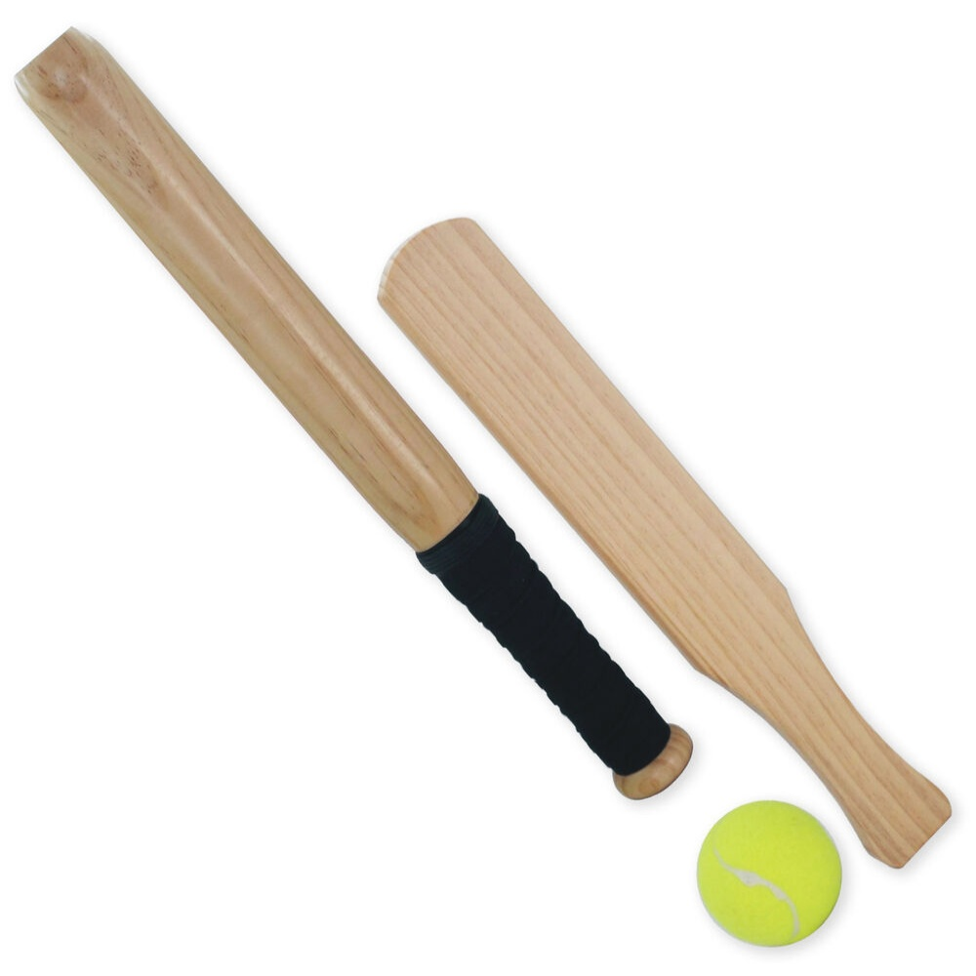
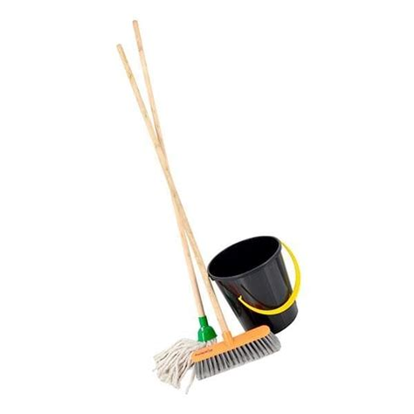
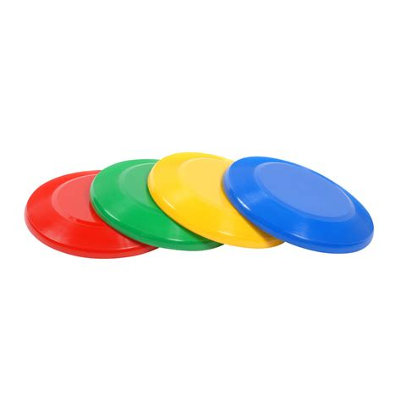

SBU – Games and materials for the studystart
Bathtub; Lots of different things
Board games- Matador, Cards Against Humanity, Alias
Outdoor games - Crocket, Rundbold, frisbees, footballs
Cleaning - Mops, soap, towels
Drinks
Notes:
Ollie

Slide 14
Ups and downs
UPs
Networking
Lots of hygge!
Personal development
Education
Lots of cool experiences with co-vectors, KABS and cake-teams
4000 kr. at the end of the contract
DOWNs
  Time consuming
  (Some of easter holiday and summer holiday)
  Energy to be with other people (3. Intro-days with lots of activities)
Notes:
Cilla

Slide 15
Vector for another studyline
Vectors are guides not teachers!
Even more networking and social
Opportunity to experience another campus
It's a lot of fun!
Notes:
Cilla

Slide 16
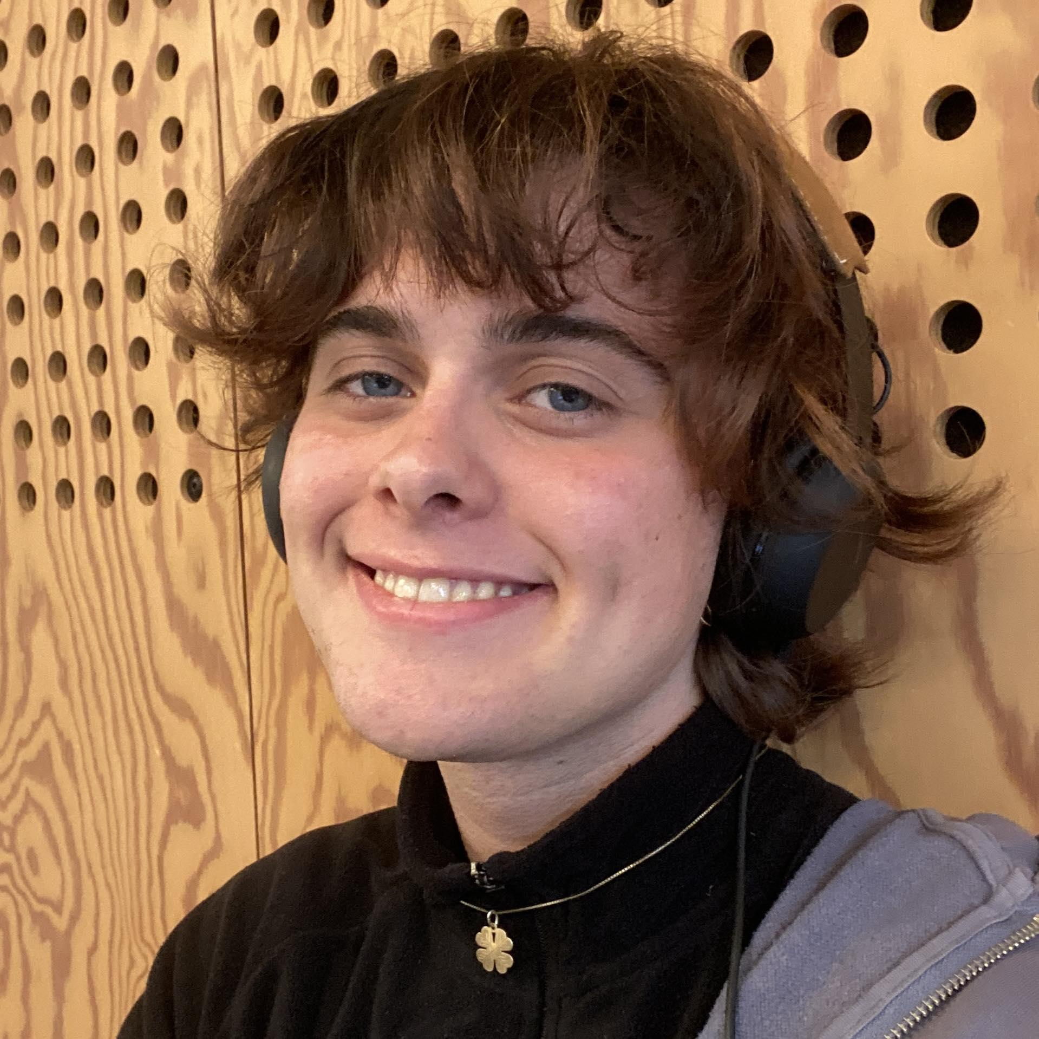
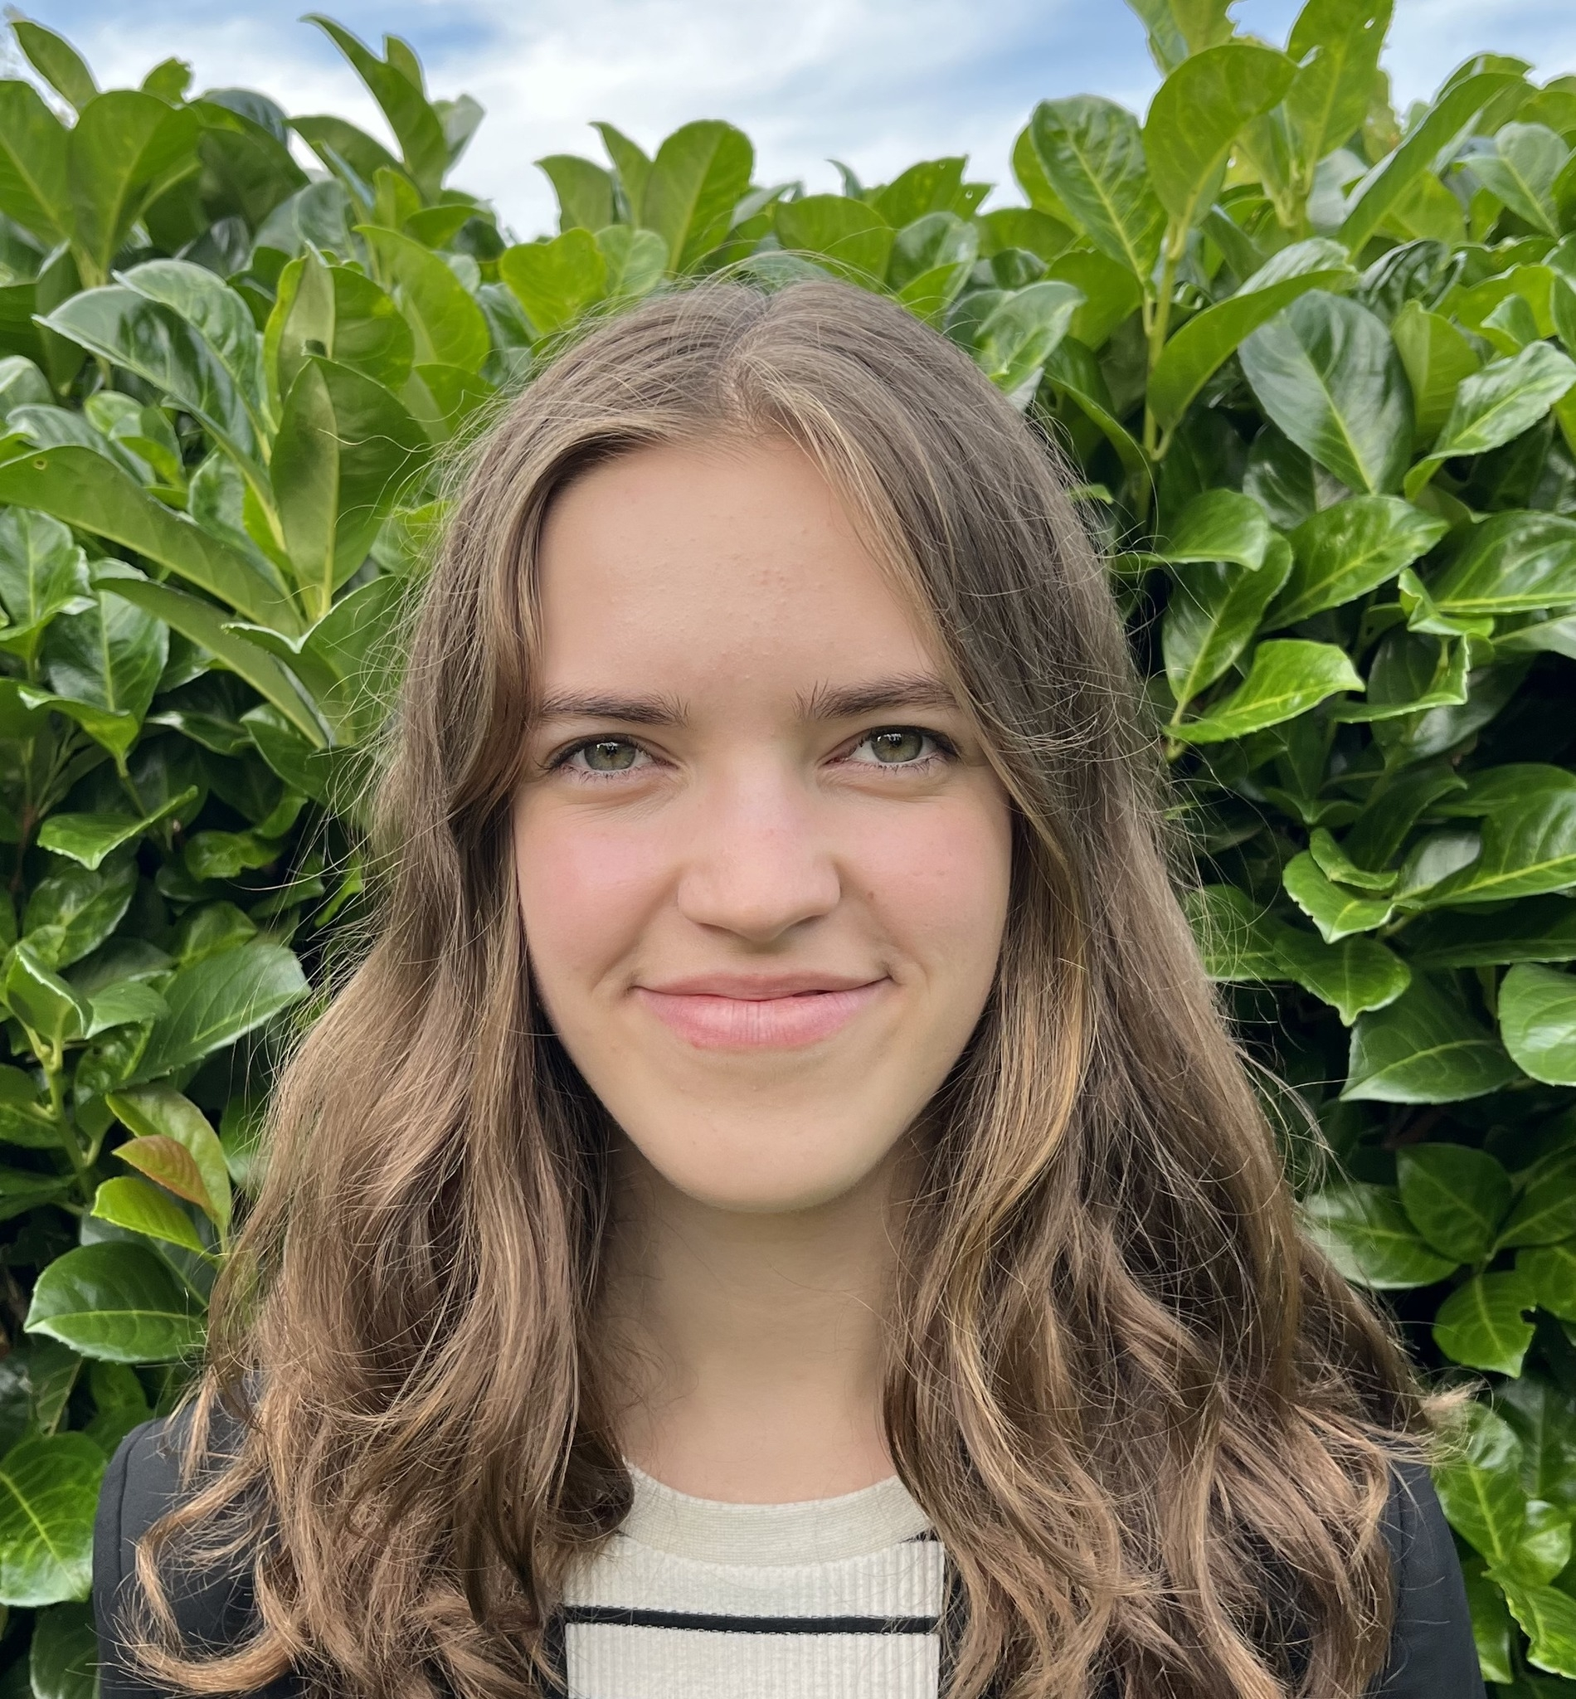
Trust-KABS
Elias Dahl Lyng
dahl@kabs.pf.dk
42522468
We are here for you!
Increased confidentiality
Nothing is too big or too small
We are available to discuss your considerations about becoming Vector
Katie Bech
katie@kabs.pf.dk
42260962
Notes:
Katie/Elias

Slide 17
Important dates
Application deadline – 13/2 kl. 23:59 (This friday)
Vectorinterviews – 16/2 - 18/2
1. Vectormeeting– 23/2 – 25/2
1. Education day– 15/3
2. education day– 19/4
Optur – 28/3-31/3
First aid course in june
Introdays– 26/8 – 28/8
Notes:
Mathias

Slide 18
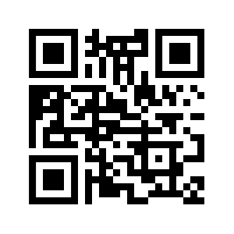
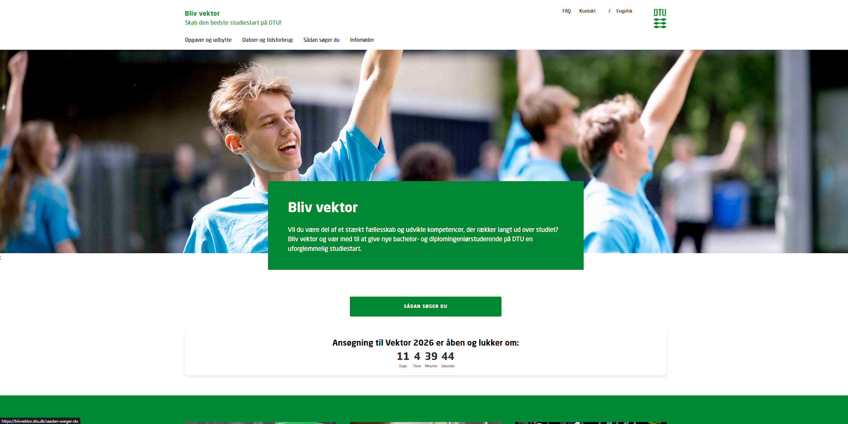
How to apply?
blivvektor.dtu.dk
Application deadline 13th of febuary
Notes:
Mathias

Slide 19
Questions???
Write questions to prkabs@pf.dk
Notes:
Lucas (og andre der vil tage imod spørgsmål)

Slide 20
We are excited to see you at the vector-interviews☺

